Slide 1
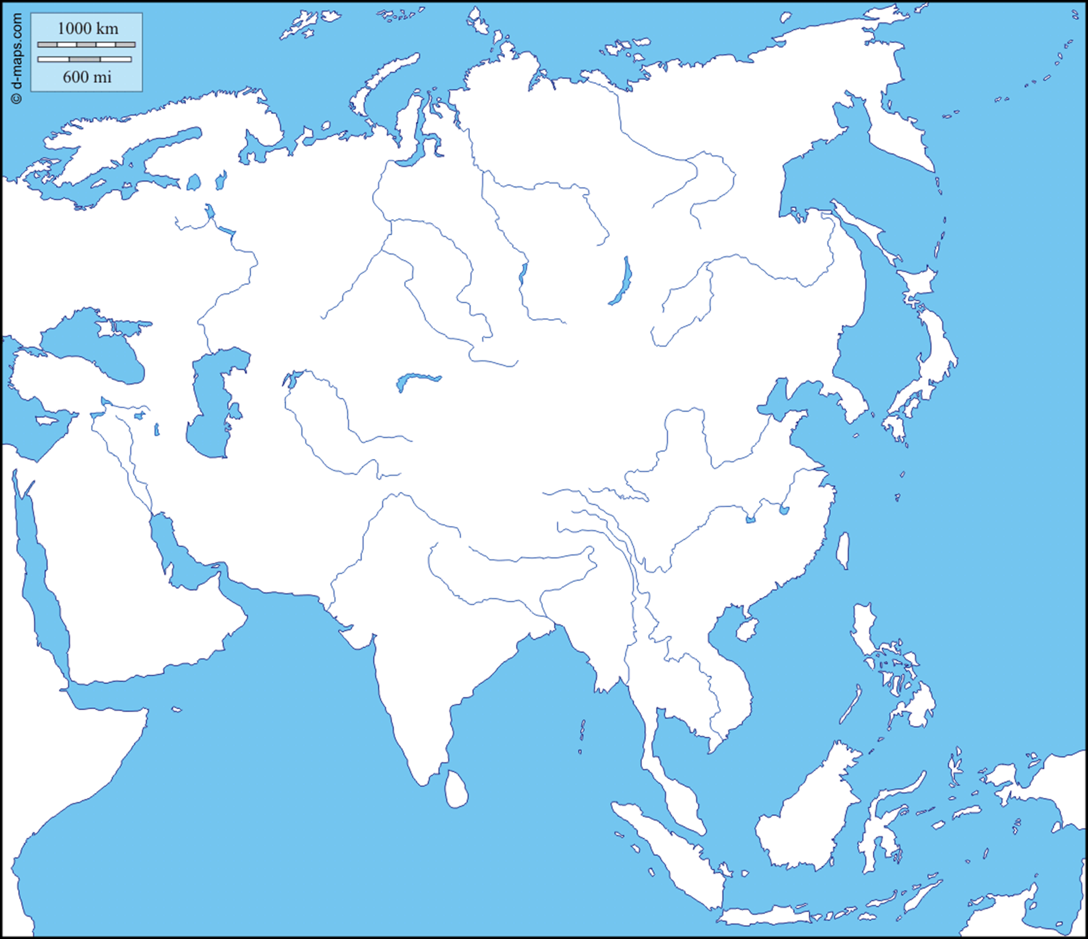
Bodies of Water

Slide 2
Mediterranean Sea

Slide 3
Black Sea

Slide 4
Caspian Sea

Slide 5
Aral Sea

Slide 6
Red Sea

Slide 7
Persian Gulf

Slide 8
Gulf of Aden

Slide 9
Gulf of Oman

Slide 10
Arabian Sea

Slide 11
Indian Ocean

Slide 12
Lake Balkash

Slide 13
Lake Baikal

Slide 14
Arctic Ocean

Slide 15
Kara Sea

Slide 16
Laptev Sea

Slide 17
East Siberian Sea

Slide 18
Bering Sea

Slide 19
Mountain Ranges

Slide 20
Hejaz Asir

Slide 21
Zagros

Slide 22
Elburz

Slide 23
Caucusus

Slide 24
Ural

Slide 25
Tien Shan

Slide 26
Hindu Kush

Slide 27
Verkhoyanski

Slide 28
Cherski

Slide 29
Other Features and Rivers

Slide 30
Scandinavia

Slide 31
Anatolian Peninsula

Slide 32
Arabian Peninsula

Slide 33
Plateau of Iran

Slide 34
Central Siberian Plateau

Slide 35
Volga River

Slide 36
Tigris River

Slide 37
Euphrates River

Slide 38
Strait of Hormuz

Slide 39
Plateau of Iran

Slide 40
Amu Dar’Ya

Slide 41
Syr Dar’ya

Slide 42
Ob River

Slide 43
Irtysh River

Slide 44
Lena River

